Slide 1
VAKKAS Charity Platform for Clinical Cancer Care and for Other Catastrophic Illnesses
PHARMACY HANDBOOK
Vakkas is a NJ Non-profit Corporation with EIN46-3845991 and 501c3 application to the IRS # --------

Slide 2
SOCIAL RESPONSIBILITY and PHARMAs?
Save the PATIENT headaches
Free the SOCIAL WORKER from discounted medication research
Give visibility to PHARMAS’ social responsibility
Pharmas are the backbone of the fight against cancer and other catastrophic illnesses:
Pharmas are one of the most generous corporations. In 2007, pharmas gave their 13 % of their US income to US charities.*
What about in kind donations?
Non-cash contributions as a percentage of the total [corporate charitable] contributions grew in aggregate from 57 percent in 2007 to 69 percent in 2012.
In 2010, more than half of the $2 billion increase in corporate philanthropy came from pharmas donating medicine through their Patient Assistance Programs.**
In 2011, a survey found that 19% of all pharmas’ charitable donations were gifts
in kind.***

Slide 3
Ready to lend a hand, Pharma?
*Not all oncology social workers are aware of all the patient medication assistance sites out there.
* Often, they do not have the time to research and keep up with the changing parameters of eligibility.
That’s where VAKKAS can help:
*Patients go to one site, and list the medications they need—rather than going to many sites to look for what they need.
*Pharmaceutical companies can donate medication coupons to VAKKAS
VAKKAS gets them where they need to go.
1st Simply register at VAKKAS.org, or log in as a guest.
2nd Scroll through the lists of medications listed by VAKKAS Patients.
3rd Send an email to VAKKAS if you want to send coupons, and we’ll get
them where they need to go.

Slide 4
VAKKAS—EVERYONE teams up to help the patient.
Hospitals
No more financial worries of medical debt
No more running after free medications
Just fight the cancer!
Outstanding patient balances down
Database of patients open to
clinical trials
Patients
Contributors
Pharma
Message Board of Needed Medications
Comparative visibility of
social responsibility
Choice over donation criteria
Transparency over where the money goes

Slide 5
VAKKAS Charity Platform for Clinical Cancer Care and for Other Catastrophic Illnesses
VAKKAS believes that patients with cancer and other catastrophic illnesses should only worry about their treatment, and not finances.
In a system where three out of five* bankruptcies are filed due to medical bills, and the total of uninsured and under-insured patients is significant, VAKKAS is committed to genuinely helping patients in need
by infusing transparency and connectivity into charity donations
&
by empowering smart and caring philanthropists
Source: * http://www.cnbc.com/id/100840148
** http://www.healthcareproblems.org/health-care-statistics.htm

Slide 6
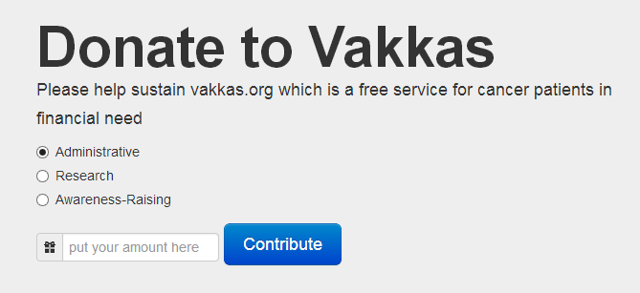
Do you like what we do at VAKKAS?
Please consider making a tax-exempt donation to VAKKAS for helping us advance our mission faster.
We are as transparent in our organizational donations as we are with our donations in honor of patients. If you want to give to VAKKAS to support our organization, you can advise us on your donations.

Slide 7
ANY QUESTIONS, WE ARE A CLICK AWAY!
www.vakkas.org
https://www.facebook.com/vakkascharity
OR EMAIL US: information@vakkas.org
TWIT US @vakkascharity

