Slide 1
VAKKAS Charity Platform for Clinical Cancer Care and for Other Catastrophic Illnesses
HOSPITAL HANDBOOK
Vakkas is a NJ Non-profit Corporation with EIN46-3845991 and a tax-exempt 501(c)(3) granted by the IRS # --------

Slide 2
WHAT IS VAKKAS?
VAKKAS is a tax-exempt 501(c)(3) and online platform that connects the following individuals/groups/entities:
--Cancer patients with approved financial needs who receive or have received clinical treatment for cancer or other catastrophic illnesses at federally recognized hospitals in the United States.
--Contributors who make tax-deductible donations to VAKKAS in honor of patients and/or disease-related causes toward the payment of patients’ hospital bills for their clinical cancer treatment or treatment for their catastrophic illness.
--Hospitals and Pharmaceutical companies can donate by sponsoring the clinical treatment of a patient, including through clinical trials and psycho-social treatment.
--Pharmaceutical companies can donate medication coupons which VAKKAS will transmit to the hospitals of the patients with the stated medication needs.
All donations to VAKKAS will be sent to Patients’ Hospital Accounts uniquely for their treatment.
VAKKAS does not charge any fees. It does not take any portion of the donations.

Slide 3
HOW DOES VAKKAS WORK WITH HOSPITALS?
VAKKAS is an independent public charity and does not have any formal or informal links with any hospital.
If patients can prove their eligibility, they can use VAKKAS’ site for a chance to be matched with possible contributors who can donate to VAKKAS in their honor or toward their outstanding hospital treatment cost. Tax-deductible donations are sent by VAKKAS to patients’ hospital accounts.
If and when contributions are not made in honor of patients but for certain causes (eg. a specific diagnosis), VAKKAS specifies to the hospital the criteria of the contributions, and donations are channeled in line with these criteria to other VAKKAS patients.
HOSPITALS are not charities. VAKKAS is.
A patient-centric and transparent CANCER CHARITY PLATFORM.

Slide 4
HOSPITALS CAN ALSO BECOME PHILANTHROPIC CONTRIBUTORS
The delays in patient recruitment for clinical trials account for an annual cumulative loss of 26 years, on average, for each institution, per trial.*
Once the Social Worker/Nurse Navigator registers with Vakkas.org , hospital can search the database of patients who have indicated interest in clinical trials, and contact VAKKAS if they would like to donate clinical treatment or trial program to a patient.
If VAKKAS PATIENT reconfirms interest, VAKKAS will provide the interested Hospital’s information to the Patient. VAKKAS will not provide patient information to the Hospital.
Once a patient accepts a clinical trial offer, he/she posts a Thank you Note, and is considered to be fully adopted / funded.
Source: * http://www.ciscrp.org/professional/facts_pat.html

Slide 5
VAKKAS—EVERYONE teams up to help the patient.
Hospitals
No more financial worries of medical debt
No more running after free medications
Just fight the cancer!
Outstanding patient balances down
Database of patients open to
clinical trials
Patients
Contributors
Pharma
Message Board of Needed Medications
Comparative visibility of
social responsibility
Choice over donation criteria
Transparency over where the money goes

Slide 6
VAKKAS Charity Platform for Clinical Cancer Care and for Other Catastrophic Illnesses
VAKKAS believes that patients with cancer and other catastrophic illnesses should only worry about their treatment, and not finances.
In a system where three out of five* bankruptcies are filed due to medical bills, and the total of uninsured and under-insured patients is significant, VAKKAS is committed to genuinely helping patients in need
by infusing transparency and connectivity into charity donations
&
by empowering smart and caring philanthropists
Source: * http://www.cnbc.com/id/100840148
** http://www.healthcareproblems.org/health-care-statistics.htm

Slide 7
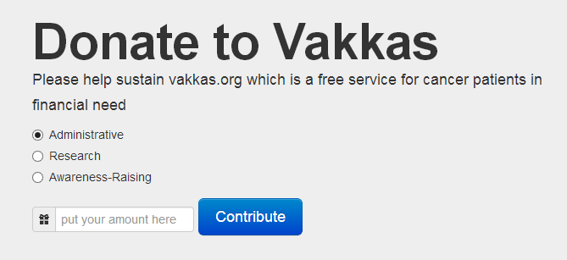
Do you like what we do at VAKKAS?
Please consider making a tax-exempt donation to VAKKAS for helping us advance our mission faster.
We are as transparent in our organizational donations as we are with our donations in honor of patients. If you want to give to VAKKAS to support our organization, you can advise us on your donations.

Slide 8
ANY QUESTIONS, WE ARE A CLICK AWAY!
www.vakkas.org
https://www.facebook.com/vakkascharity
OR EMAIL US: information@vakkas.org
TWIT US @vakkascharity

