Slide 1

VAKKAS
Charity Platform for Clinical Cancer Care and for Other Catastrophic Illnesses
CONTRIBUTOR HANDBOOK
Vakkas is a NJ Non-profit Corporation with EIN46-3845991 and 501c3 application to the IRS # --------

Slide 2
FIGHT AGAINST CANCER:
What are your options?
So you hate cancer... Perhaps you have lost a loved one to cancer, or you are a lucky one, and you have seen a loved one thrive against cancer at the end of a long battle.
Or you have been through that ordeal yourself. It looks like a longtime ago but so real…
Or perhaps you are simply a conscious individual who cares about those who wake up everyday knowing that cancer is still inside them.
And YOU WANT TO HELP.
Just think about those who can barely afford their treatment…
Cancer Patients
Number of Uninsured in the US
16 m
in 2003
30 m
in 2012
45 m
in 2013
Plus 25 m underinsured
1/3
of all Americans report difficulty paying for medications
3 out of every 5 bankruptcy filings were due to medical

Slide 3

How can you HELP?
VAKKAS APPROACH
HELP A REAL PERSON
MAKE A TAX-EXEMPT DONATION
KNOW exactly HOW YOUR DONATION IS SPENT
DO NOT PAY ANY FEES
ADOPT A PATIENT. CONTRIBUTE TO A CAUSE. SAVE A LIFE…TODAY!
One Approach:
SEND IN YOUR CHECK &
FEEL BETTER APPROACH
You could make monthly or sporadic contributions to non-profits that fight against cancer—through research, patient assistance, advocacy…
Send in your check and you can sleep well that you have done your share.
But how exactly? And what percentage of your donation goes really to help others, and not to direct mail companies?
That is up to the non-profit.
Another Approach:
LISTEN TO A STORY &
CLICK-and-PAY APPROACH
You could also go to one of the several for-profit social entrepreneurship sites and choose a real person who wholeheartedly shares his/her story.
You are so moved that you click and the person of your choice receives your contribution.
But again, how is your contribution spent exactly?
Of course, you know for sure that a small percentage of your donation (usually around 7 percent) goes to the profit-making site.

Slide 4
How to use VAKKAS to fight cancer?
You register WITH VAKKAS.org or sign in as a guest.
You choose a patient or patients that you would like to help. Perhaps someone with the same diagnosis as your loved one, or someone from the same state or town, or your old hospital!
You send your tax-exempt donations to VAKKAS in honor of the patient(s) and uniquely for their hospital treatment. Not to the patients, not for things other than their clinical treatment! VAKKAS sends them to the hospital account(s) of the patient(s).
You can contribute not only to chemotherapy or radiation cost but to the healing of the mind through psycho-social support.
The goal is to make sure that patients do not have to worry about how they are going to afford treatment.
3 out of 5 bankruptcies in the United States are due to medical bills.
Cancer treatment and treatment for other catastrophic illnesses often means a choice between a mortgage and good health, between a good and a ruined credit score.
It should not be so! Adopt a Patient. Save a Life…Today!
Or simply contribute to your chosen cause!

Slide 5
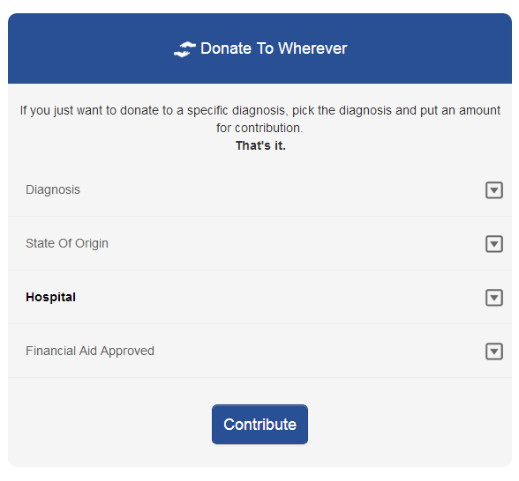
What are your VAKKAS donation plan options?
Once you chose your patient(s), you can ADOPT them by paying all of their hospital bills or any one of the three specific parts: hospital bills, psycho-social support and medications
or by dividing the whole bill or your chosen parts of it into monthly installments in line with your own budget and needs.
Or you can simply make a one time donation of the amount you would like. Every bit helps…
You can also fight a specific cancer or diagnosis rather than donating in honor of patients. Just choose Donate to a Cause and give us your advice on how you want your donation to help
You can see your donations going to help a specific disease in a specific state or hospital.
You will receive a THANK YOU note from the patient(s) in honor of whom you make your tax-deductible donations.
Now, you truly know how your donation is making a difference!
Hospital
Bills
Psycho-social
Rx

Slide 6
VAKKAS
Where your donations go to patients’ treatment in hospitals
You get to say how you want to help
Patient Criteria
Treatment COST
Gender
Donation Options
Lump-sum donation
total or parts (Hospital Bill, PS needs, Medications) of the TREATMENT COST
Age
Hospital Bills
ADOPT
(or contribute to)
A PATIENT
Diagnosis
Monthly payments
total or parts (Hospital Bill, Psycho-Social needs, Medications) of the TREATMENT COST
Psycho- Social (PS) Needs
School
DONATE TO A CAUSE
Do NOT want to adopt a patient?
Give us your advice on your donation (diagnosis, state, hospital…)
State
Medications
Hospital
Story

Slide 7
VAKKAS is for smart philanthropists who care.
Rest assure that the hospital bills of VAKKAS patients are reasonable insurance-negotiated rates (since they are 501(c)(3) Hospitals, and if not, they provide written statement that they charge such rates).
All VAKKAS patients’ financial eligibility is verified and approved by their 501(c)(3) hospitals as result of Patient Financial Assistance Form application process.
VAKKAS does not charge any fees nor does it take any percentage off of donations.
If you want to stay anonymous, you can. Just choose: Make my info private!
Your contact information is never made public.
VAKKAS does not collect credit card information. We only work with PayPal.
VAKKAS will not share any information with any other party.
See our Terms of Use and Privacy Policy for more information.

Slide 8
VAKKAS—EVERYONE teams up to help the patient.
Hospitals
No more financial worries of medical debt
No more running after free medications
Just fight the cancer!
Outstanding patient balances down
Database of patients open to
clinical trials
Patients
Contributors
Pharma
Message Board of Needed Medications
Comparative visibility of
social responsibility
Choice over donation criteria
Transparency over where the money goes

Slide 9
VAKKAS
Charity Platform for Clinical Cancer Care and for Other Catastrophic Illnesses
VAKKAS believes that patients with cancer and other catastrophic illnesses should only worry about their treatment, and not finances.
In a system where three out of five* bankruptcies are filed due to medical bills, and the total of uninsured and under-insured patients is significant, VAKKAS is committed to genuinely helping patients in need
by infusing transparency and connectivity into charity donations
&
by empowering smart and caring philanthropists
Source: * http://www.cnbc.com/id/100840148
** http://www.healthcareproblems.org/health-care-statistics.htm

Slide 10

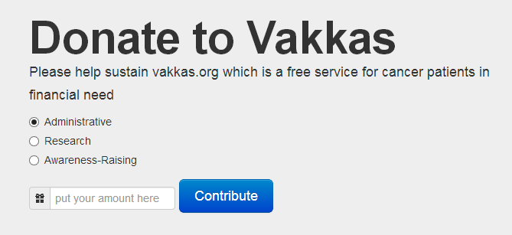
Do you like what we do at VAKKAS?
Please consider making a tax-exempt donation to VAKKAS for helping us advance our mission faster.
We are as transparent in our organizational donations as we are with our donations in honor of patients. If you want to give to VAKKAS to support our organization, you can advise us on your donations.

Slide 11


ANY QUESTIONS, WE ARE A CLICK AWAY!
www.vakkas.org
https://www.facebook.com/vakkascharity
OR EMAIL US: information@vakkas.org
TWIT US @vakkascharity

